Slide 1
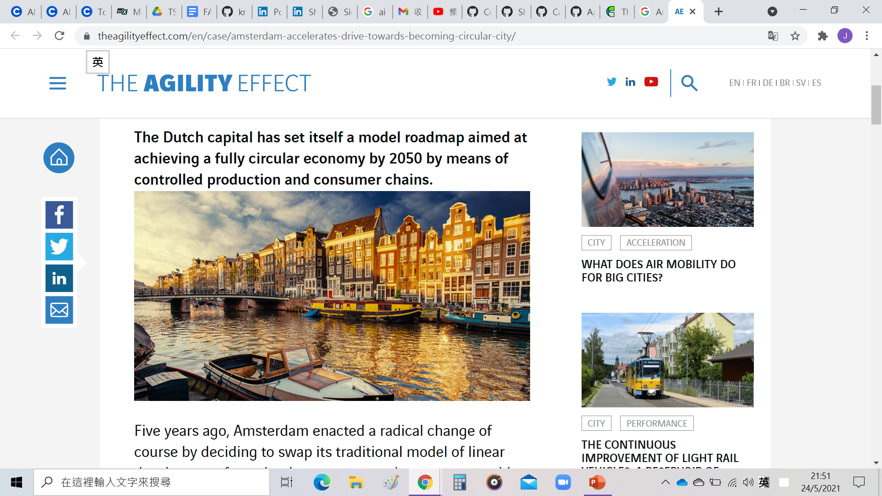
IBM Data Science capstone project
The Battle of Neighborhoods –
analyzed on Amsterdam
By Analyst Tse Kit Yee 23/05/2021

Slide 2
Business problem
Is the place suitable for opening a restaurant?
Is it a good place for a constracter to start his/her own business, i.e. to setup his/her office?
Our goal
To analyze: Is Amsterdam being a well multicultural place to satisfy the above two main business problem?

Slide 3
Introduction on Amsterdam
The largest city in the Netherlands
Have a population of 1.16 million
This place with approximately 178 different cultural backgrounds
It hosts many cultural events throughout the year, which emphasizes their worldly view

Slide 4
description of dataset
Data scraping from https://en.wikipedia.org/wiki/Category:Neighbourhoods_of_Amsterdam to get Neighbourhoods of Amsterdam
Use geopy library to get the latitude and longitude values of Amsterdam
Use Foursquare API to get data of venue

Slide 5
Methodology
Explore and load dataset from website link
Data transformation by pandas
Use one-hot encoding to do features extraction
Get latitude and longitude values of Amsterdam and plot the map
Apply FourSquare API in all the neighbourhoods on Amsterdam
Use k-means clustering to visualize the clusters

Slide 6
Thank you!
End of week 4’s task

